Slide 1
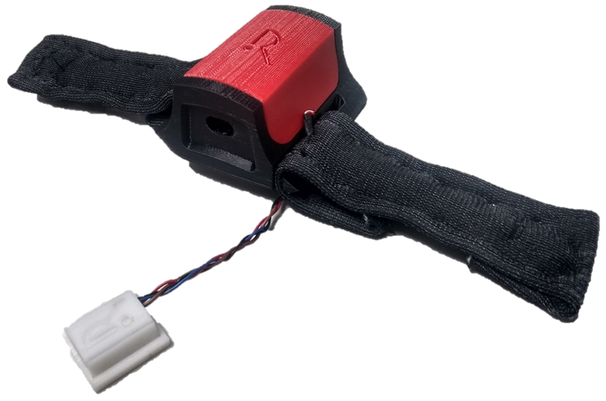
RehApp
Rehabilitation’s coming home.
Estarellas García, Mar
Jedeikin, David
Macabuag, Nathan
McLaughlin, Edward
Mitchell, Jacob
RehApp

Slide 2
Needs identification & clinical relevance
Our solution
How it works
The benefits
RehApp

Slide 3
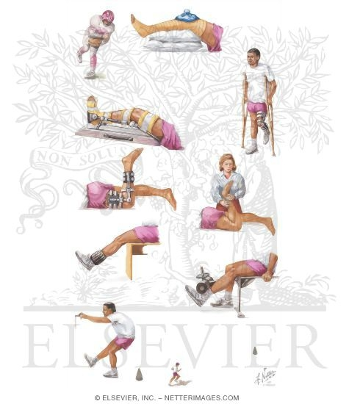
Needs identification & clinical relevance
No clear instructions for rehabilitation protocol.
Incomplete and unclear rehabilitation.
RehApp
Notes:
REHABILITATION TODAY
Clinicians time is very expensive. The average Physiotherapist in the United States can expect to rake in roughly $70K annually
Patients often don’t know if they are doing the exercise correctly.
100,000 ACL reconstructions performed annually, in the United States alone.
Median immediate procedure cost was $9399.49. Median total health care utilization cost was $13,403.38. For patients who had more than 1 reconstruction captured in the database, total health care utilization costs were higher for the second procedure than the first procedure ($16,238.43 vs $15,000.36), despite the fact that immediate procedure costs were lower for second procedures ($8685.73 vs $9445.26) - RISK OF NEEDING A SECOND PROCEDURE OF NOT DOING YOUR REHABILITATION
https://www.ncbi.nlm.nih.gov/pmc/articles/PMC5302102/
Patients need to go in to see the doctor every 2-3 weeks depending on stage of rehabilitation (missing work, travel costs, stress, etc)

Slide 4
Needs identification & clinical relevance
3. 100,000 ACL reconstructions/year.
4. Median total healthcare cost per procedure: £11,000
RehApp
Notes:
REHABILITATION TODAY
Clinicians time is very expensive. The average Physiotherapist in the United States can expect to rake in roughly $70K annually
Patients often don’t know if they are doing the exercise correctly.
100,000 ACL reconstructions performed annually, in the United States alone.
Median immediate procedure cost was $9399.49. Median total health care utilization cost was $13,403.38. For patients who had more than 1 reconstruction captured in the database, total health care utilization costs were higher for the second procedure than the first procedure ($16,238.43 vs $15,000.36), despite the fact that immediate procedure costs were lower for second procedures ($8685.73 vs $9445.26) - RISK OF NEEDING A SECOND PROCEDURE OF NOT DOING YOUR REHABILITATION
https://www.ncbi.nlm.nih.gov/pmc/articles/PMC5302102/
Patients need to go in to see the doctor every 2-3 weeks depending on stage of rehabilitation (missing work, travel costs, stress, etc)

Slide 5
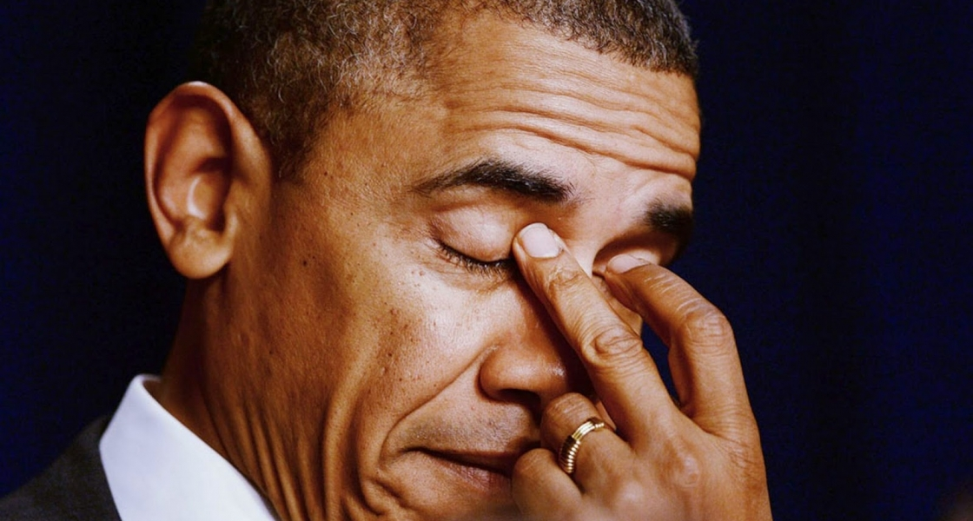
Needs identification & clinical relevance
All these can leave you feeling ...
RehApp
Notes:
REHABILITATION TODAY
Clinicians time is very expensive. The average Physiotherapist in the United States can expect to rake in roughly $70K annually
Patients often don’t know if they are doing the exercise correctly.
100,000 ACL reconstructions performed annually, in the United States alone.
Median immediate procedure cost was $9399.49. Median total health care utilization cost was $13,403.38. For patients who had more than 1 reconstruction captured in the database, total health care utilization costs were higher for the second procedure than the first procedure ($16,238.43 vs $15,000.36), despite the fact that immediate procedure costs were lower for second procedures ($8685.73 vs $9445.26) - RISK OF NEEDING A SECOND PROCEDURE OF NOT DOING YOUR REHABILITATION
https://www.ncbi.nlm.nih.gov/pmc/articles/PMC5302102/
Patients need to go in to see the doctor every 2-3 weeks depending on stage of rehabilitation (missing work, travel costs, stress, etc)

Slide 6
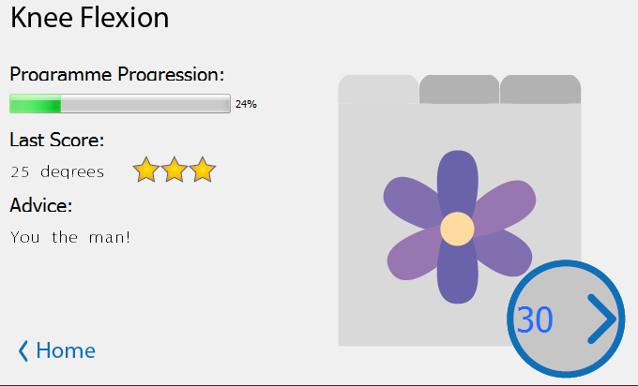
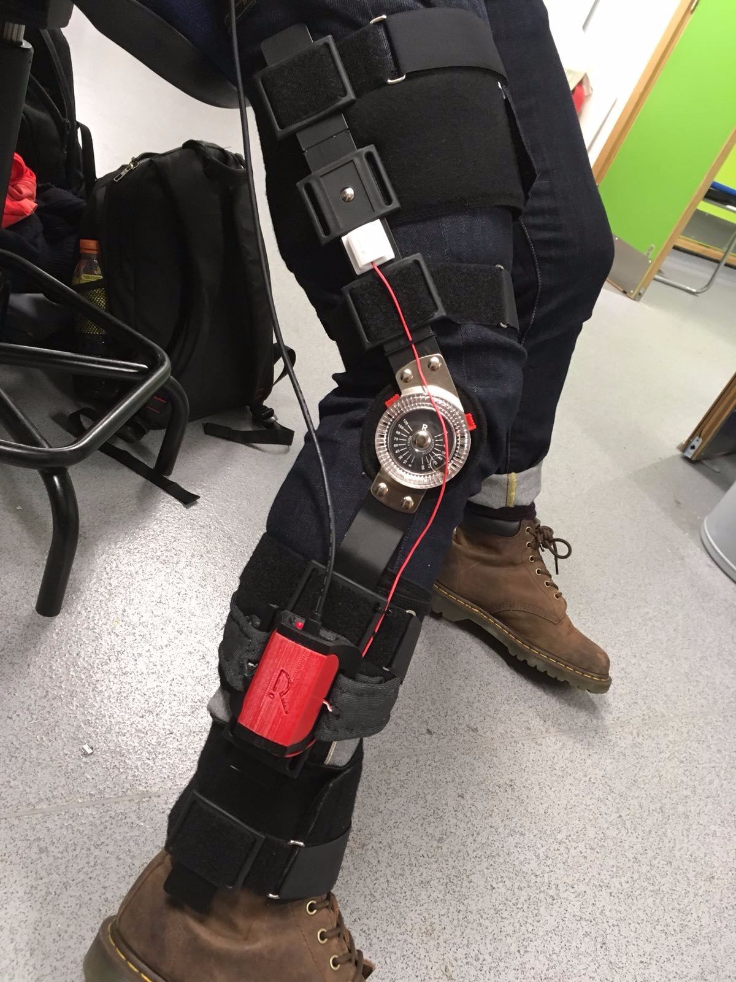
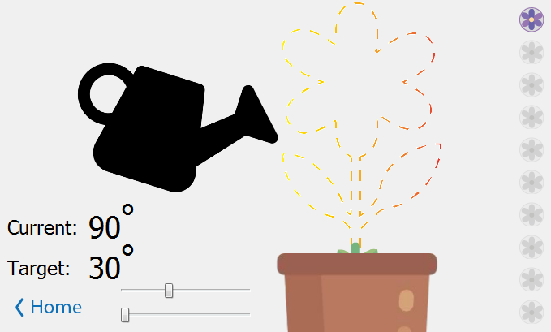
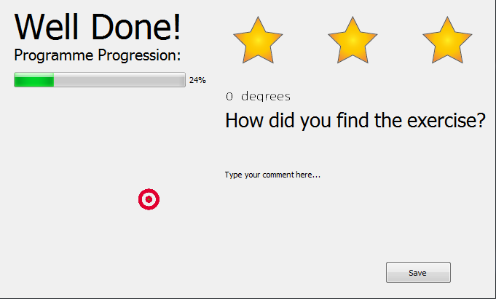
Our solution…
Software
Hardware
RehApp
Notes:
Here is our solution to the problem.
This brace is an piece of equipment which patients must wear post operation and use during rehabilitation.
Our device attaches to this brace in an easy, unambiguous manner. By which I mean, there is no confusion as to where it goes.
This leads to homogenous data collection and results which are directly comparable.
Several games have also been developed to guide the patient through performing the rehabilitation correctly, giving constant and engaging feedback.
The software gives feedback to the patient during each game, through haptic and visual feedback, and after the game through a star system and graphically showing their progress.
The software also relays the progress to a clinician who can remotely monitor the progress of the patient. Furthermore, there is functionality for two way communication through the software between the patient and the clinician.

Slide 7
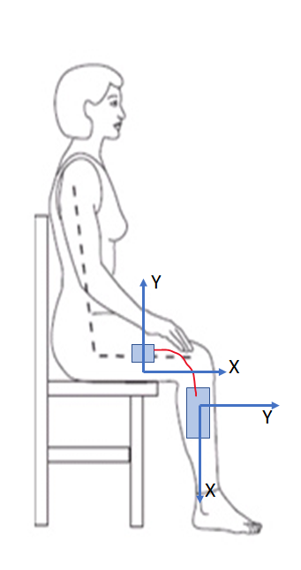
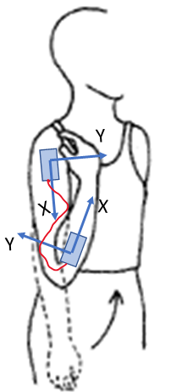
The hardware
2 IMUs
Microprocessor
Bluetooth module
Haptic motors
Leg rehabilitation
Can be extended to other joints
E.g. elbow or wrist
RehApp
Notes:
The hardware consists of two IMUs, one in the main box connected to the lower segment of the leg, and one in the satellite module connected to the upper segment of the leg. The relative rotation of the IMUs gives the real angle which the joint has rotated – this avoids cheating by lifting the upper part of the limb.
The haptic motors located on the front and back of the shin give directional feedback to complete the rehabilitation to compliment the visual interface or in cases where visual feedback is unwanted.

Slide 8
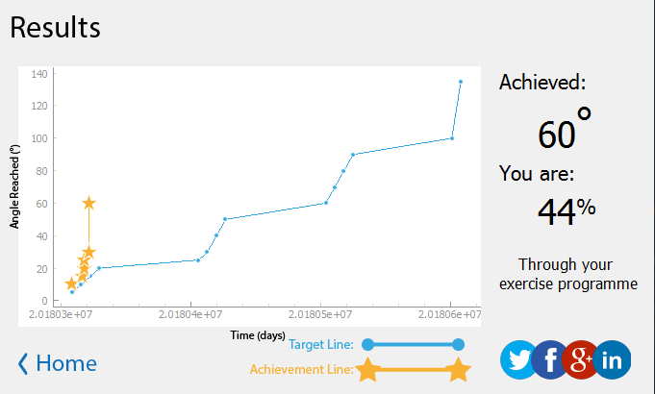
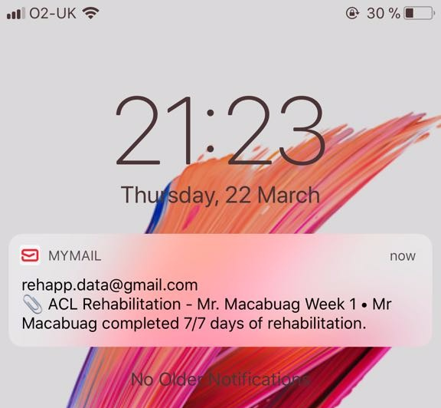
The Software
RehApp
Notes:
As well as a providing a game, the visual interface also demonstrates the progression of the patient to the patient themselves and to the clinician. This information comes automatically in the form of emails, immediately after each session and a weekly summary of exercise. A dashboard of the progression is also available through the main menu.
Here we can see some examples of the kind of data supplied.

Slide 9
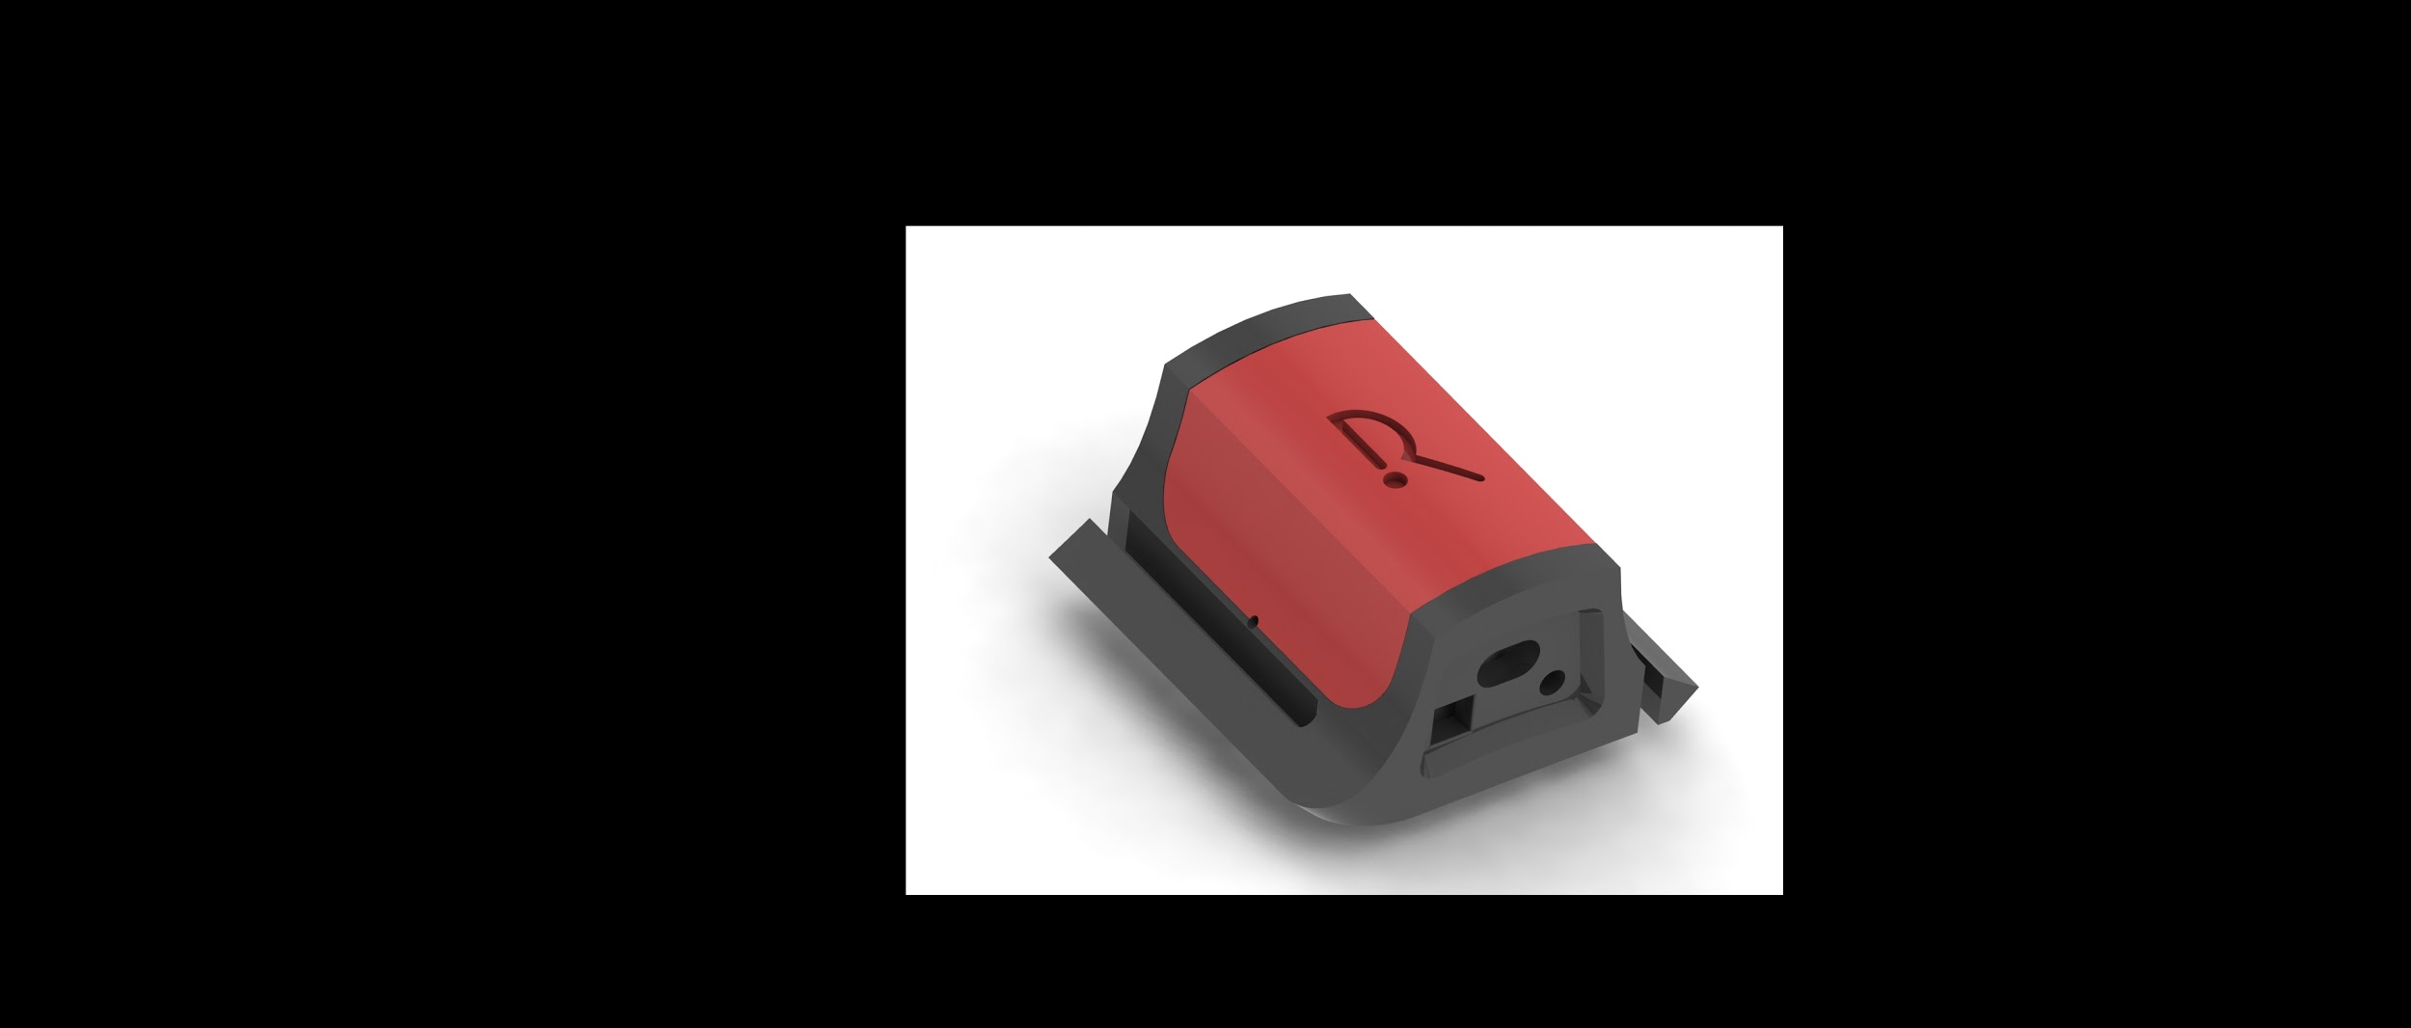
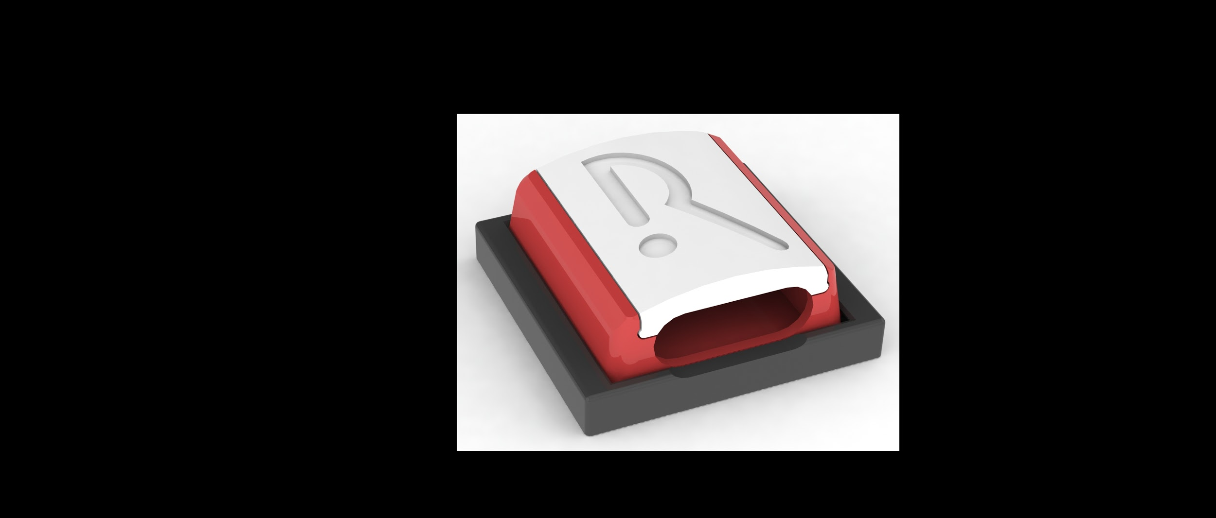
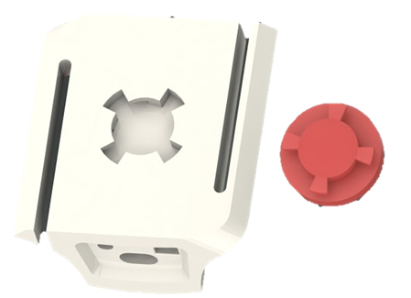
Mechanical Design
Main HUB
Satellite IMU
Attachment to the brace
Notes:
Here we can see the 3 main aspects of the mechanical design.
The main HUB which houses the microprocessor, an IMU and is where the satellite IMU and haptic sensors feed in to.
The satellite IMU case which attaches to the upper segment of the link.
The piece de resistance which is the mechanism which attaches the main hub to the brace.

Slide 10
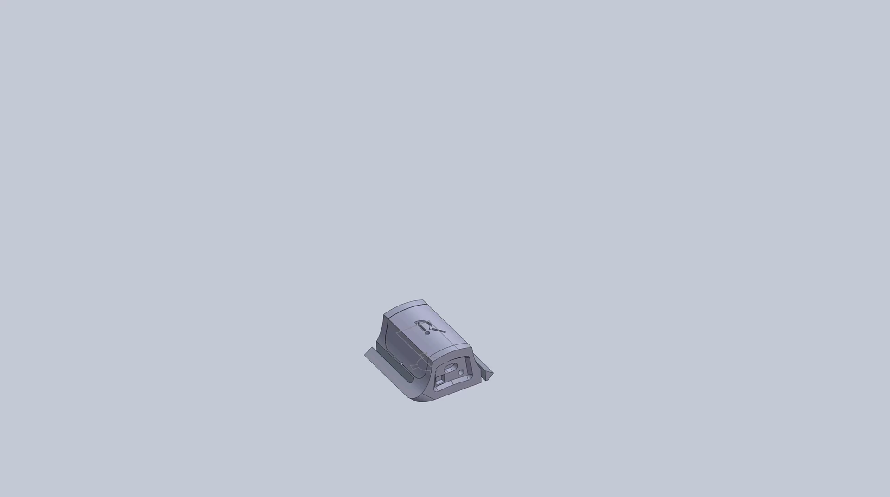

Slide 11
The benefits
What we have presented:
Makes rehabilitation
Accessible
Rewarding
Correctly performed
Portable
RehApp
Notes:
Accessible and rewarding rehabilitation for patients outside of a clinical environment.
Ensuring correct exercises are being performed with constructive feedback.
No need to be at home for rehabilitation (portable)
Week to week program which tracks your progress and compares it with the relevant recommended rehabilitation program.
More accountability for patients to do their rehab. Stops them lying to doctors about how much they are doing.
Continuous feedback from patient to clinician and clinician to patient.
Easy to understand, pre-analysed data for patients and clinicians.

Slide 12
The benefits
What we have presented:
Makes rehabilitation
Accessible
Rewarding
Correctly performed
Portable
2) Gives patients:
A week to week program to follow
Immediate and relevant feedback
An opportunity to give feedback directly and remotely to clinicians
Accountability for the amount of rehabilitation they do
RehApp
Notes:
Accessible and rewarding rehabilitation for patients outside of a clinical environment.
Ensuring correct exercises are being performed with constructive feedback.
No need to be at home for rehabilitation (portable)
Week to week program which tracks your progress and compares it with the relevant recommended rehabilitation program.
More accountability for patients to do their rehab. Stops them lying to doctors about how much they are doing.
Continuous feedback from patient to clinician and clinician to patient.
Easy to understand, pre-analysed data for patients and clinicians.

Slide 13

The benefits
What we have presented:
Makes rehabilitation
Accessible
Rewarding
Correctly performed
Portable
Gives patients:
A week to week program to follow
Immediate and relevant feedback
An opportunity to give feedback directly and remotely to clinicians
Accountability for the amount of rehabilitation they do
3) Gives clinicians:
Relevant and detailed data on their patients
More time to devote to higher priority tasks
RehApp
Notes:
Accessible and rewarding rehabilitation for patients outside of a clinical environment.
Ensuring correct exercises are being performed with constructive feedback.
No need to be at home for rehabilitation (portable)
Week to week program which tracks your progress and compares it with the relevant recommended rehabilitation program.
More accountability for patients to do their rehab. Stops them lying to doctors about how much they are doing.
Continuous feedback from patient to clinician and clinician to patient.
Easy to understand, pre-analysed data for patients and clinicians.

